Slide 1

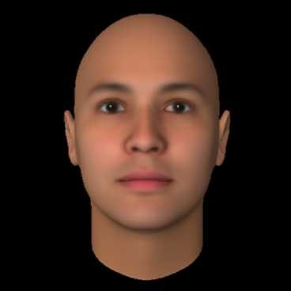
Xccelerate FTDS
Project 3 - Deep Learning
Facial Beauty Prediction
Group member:
Eva,Ian,Tony

Slide 2

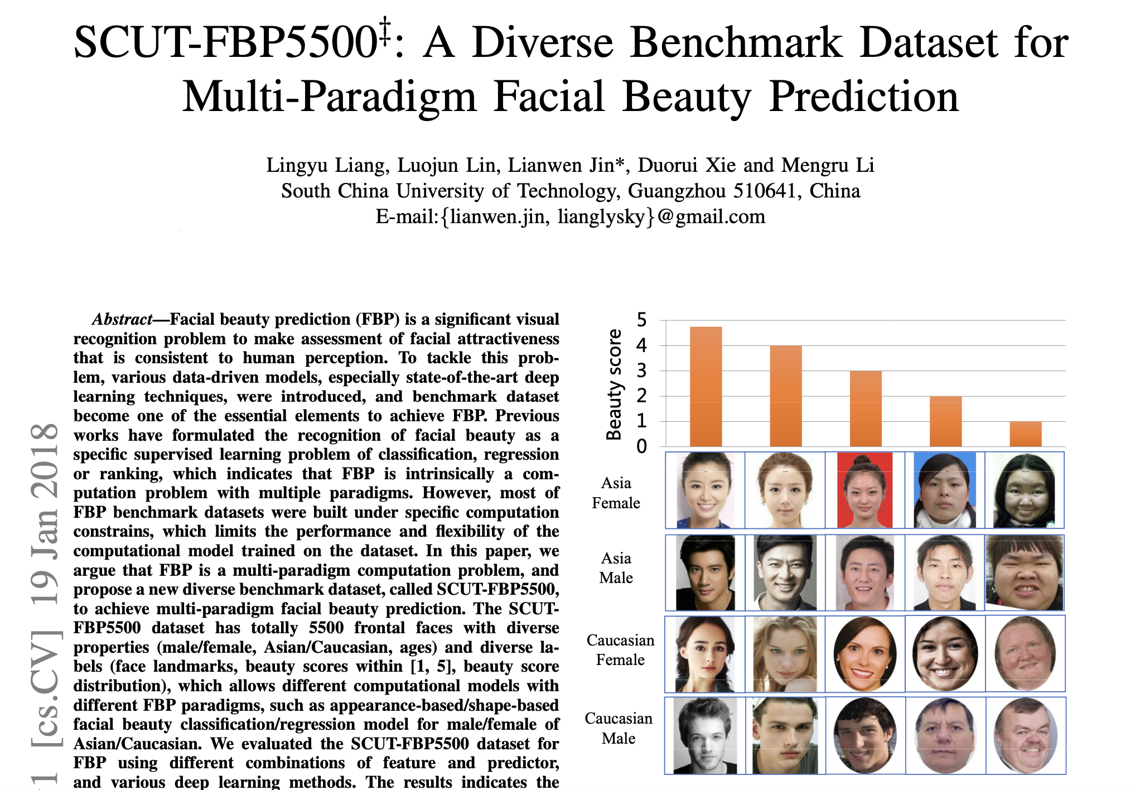

Slide 3
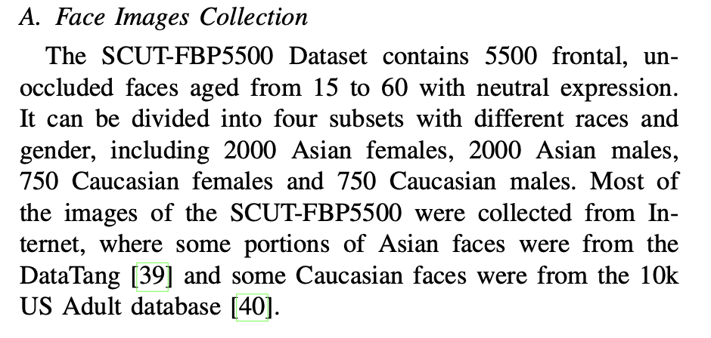


Slide 4
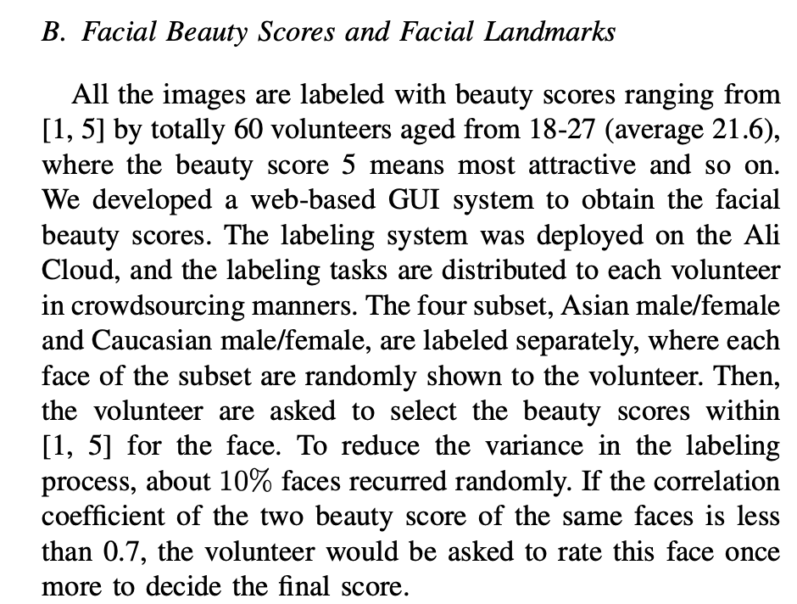
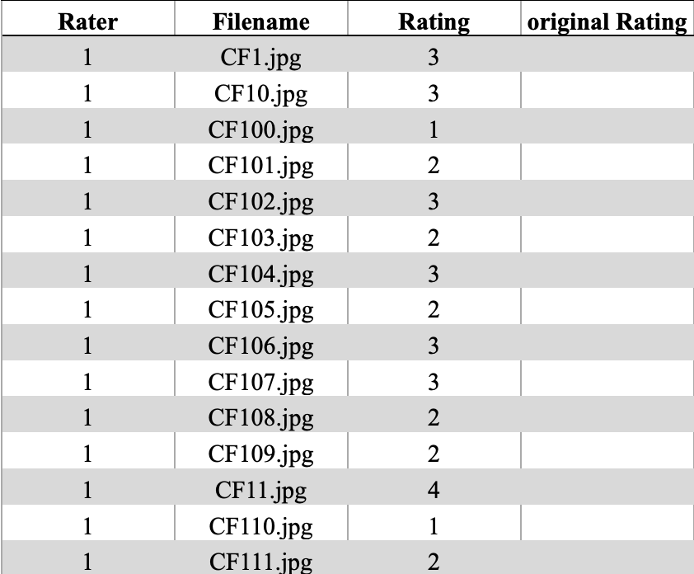
60 X 5500 = 330000 rows

Slide 5
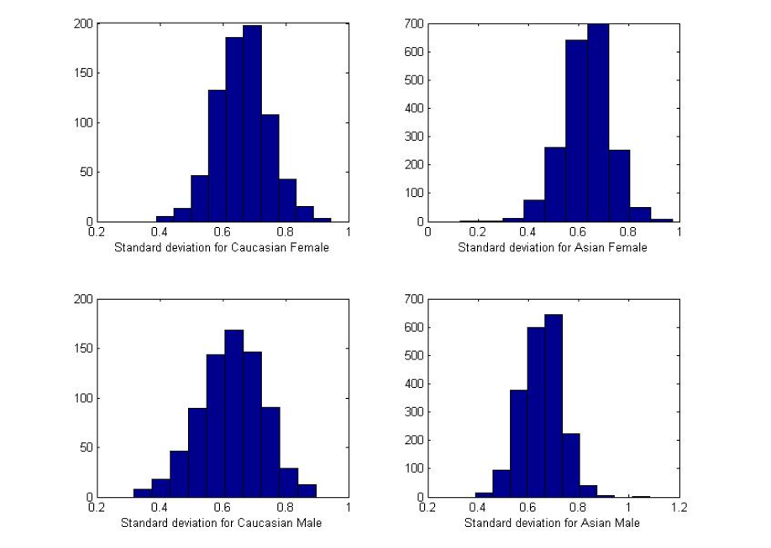
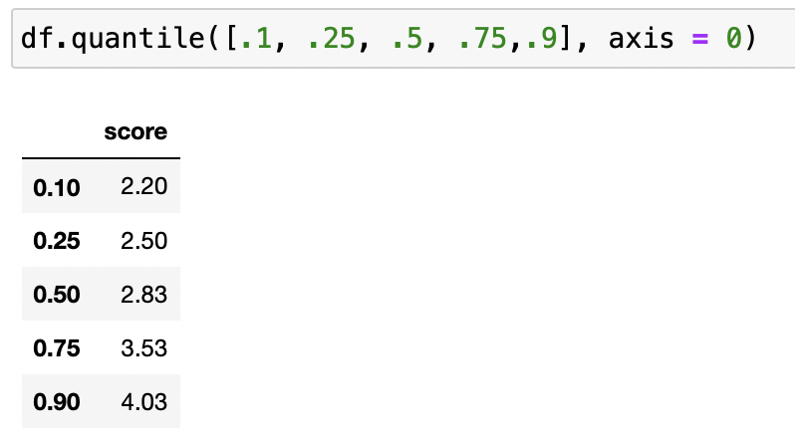

Slide 6
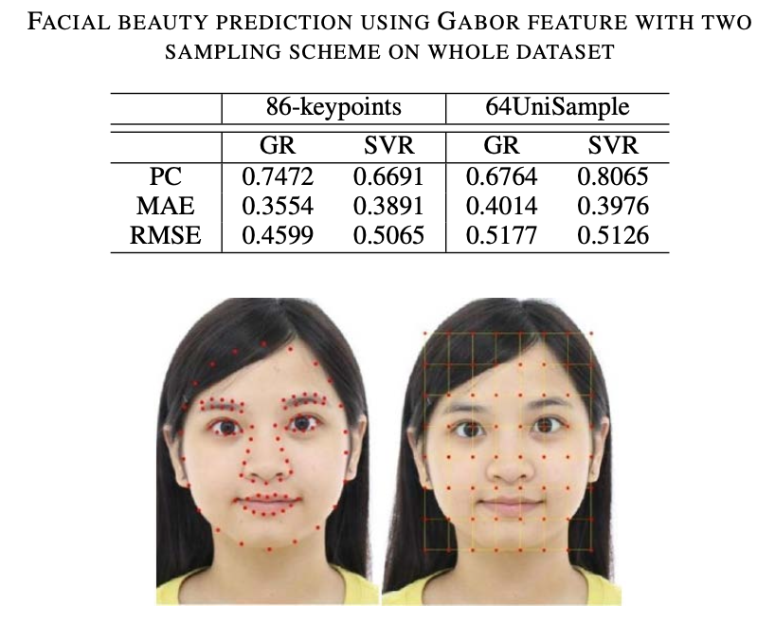

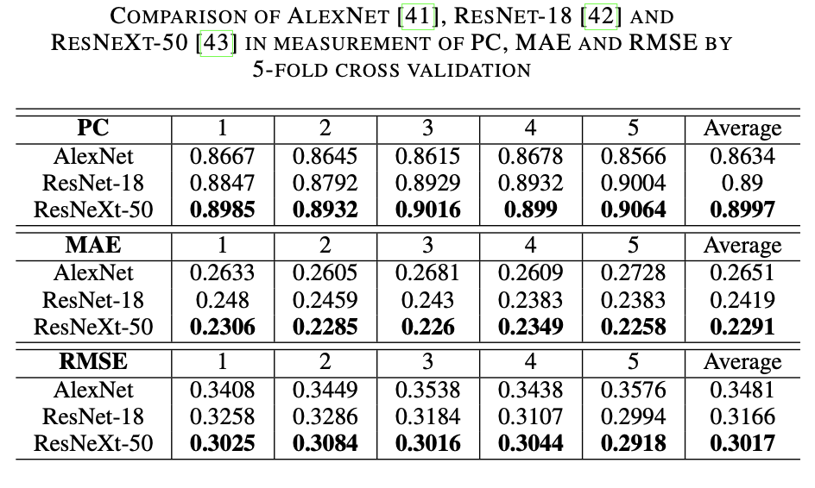

Slide 7
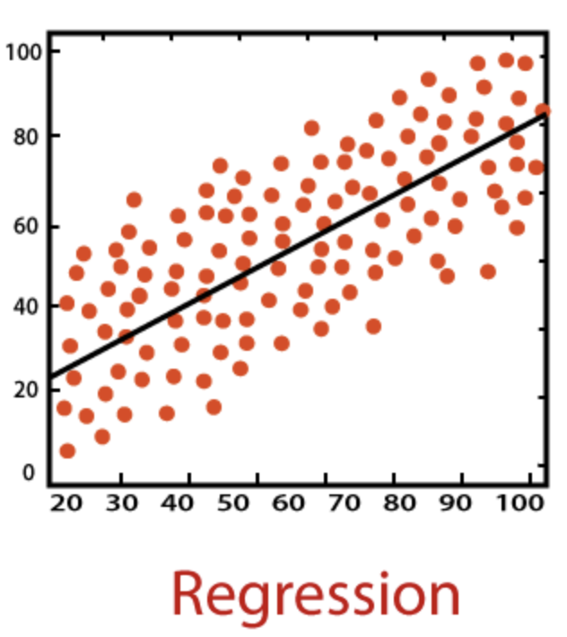
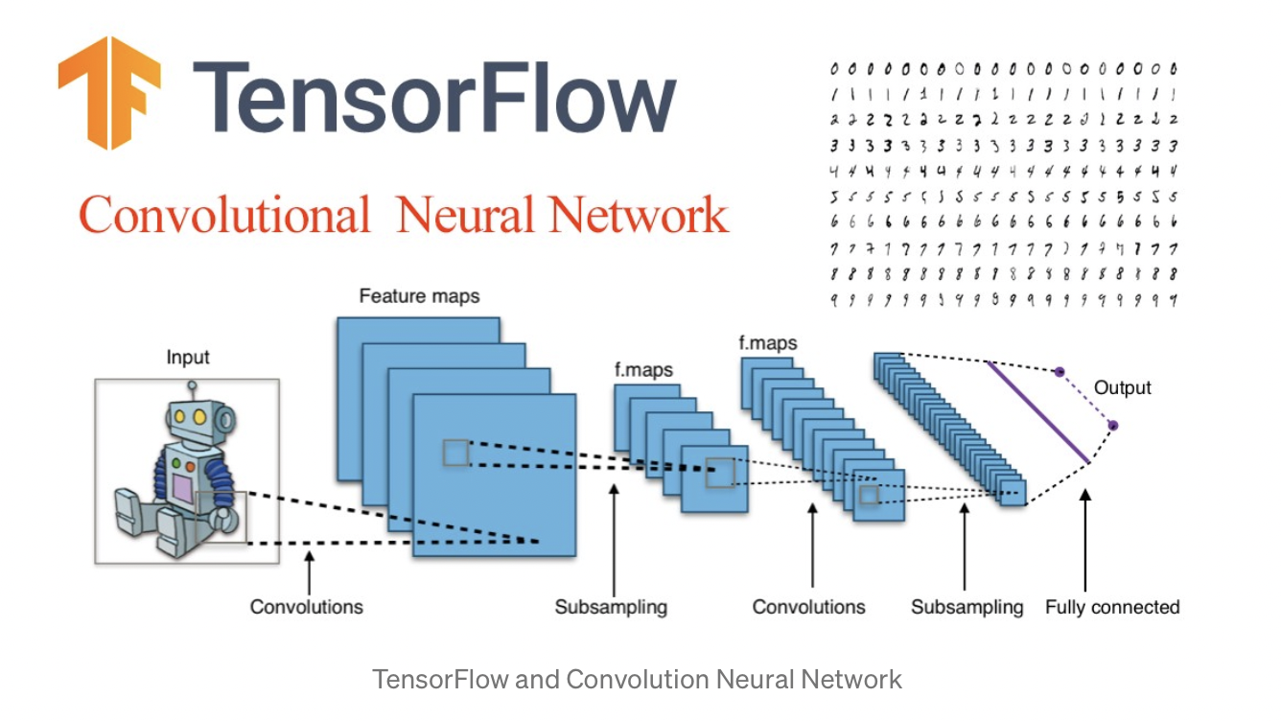
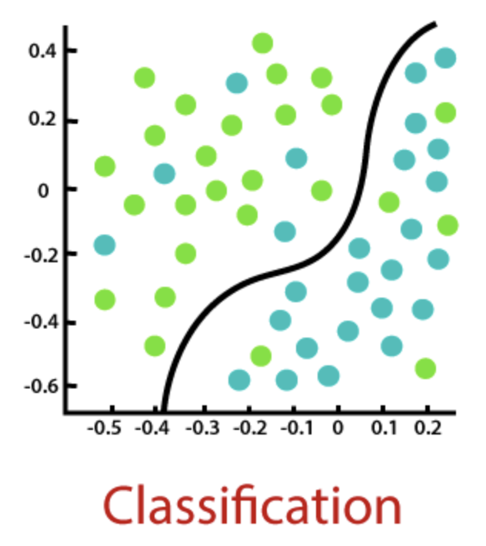

Slide 8
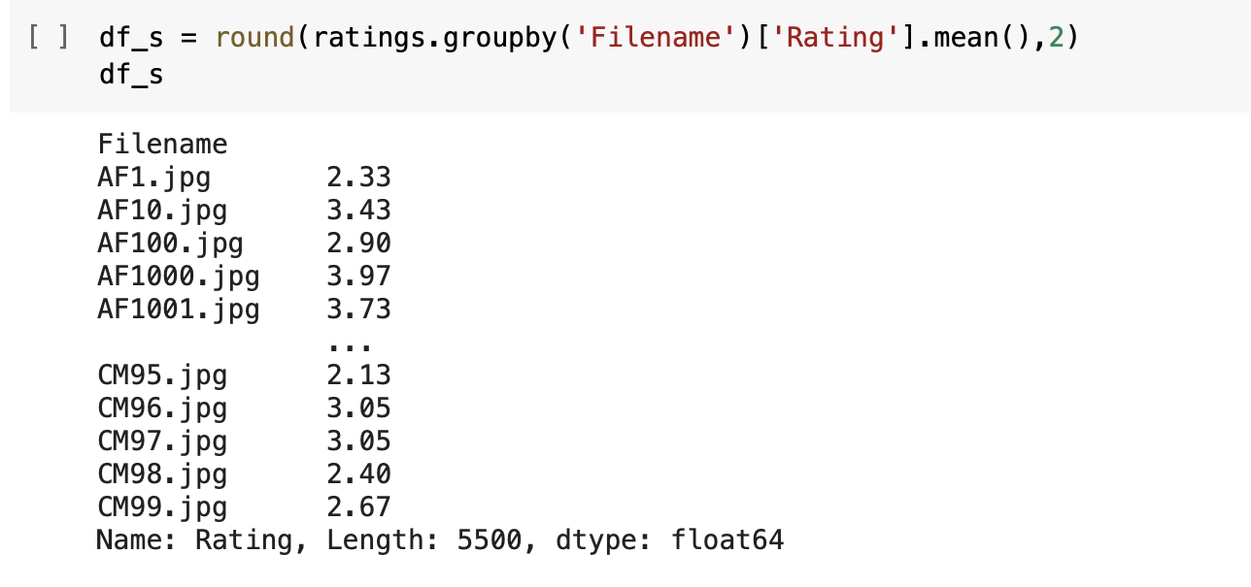
Preparing Data (Regression)
Take average of 60 scores for each photo
330,000 rows → 5,500 rows
Notes:
As we have 330,000 data, that is a large data set.
each photo has 60 score, so for the regression part, we found the mean score of each photo
just like the list, the mean score of photo AF1 is 2.33
the dataframe become 5,500 rows

Slide 9
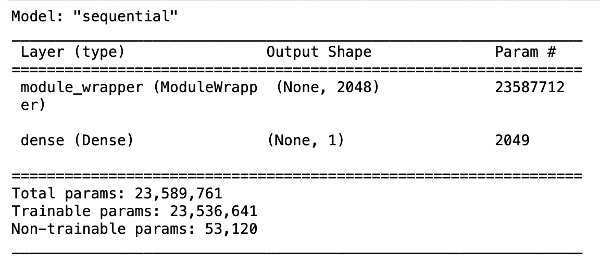
CNN model (Regression)
Pretrained model
ResNet 50
Add dense layer
batch size
16
epoch
20
image size
(350, 350)
Notes:
we used resnet50 as our pretrained model and add dense layer in the model
this is the model summary
There are 23,536,641 trainable parms and 53,120 non-trainable parms
The batch size is 16, we set 20 epoch, image size 350x350

Slide 10
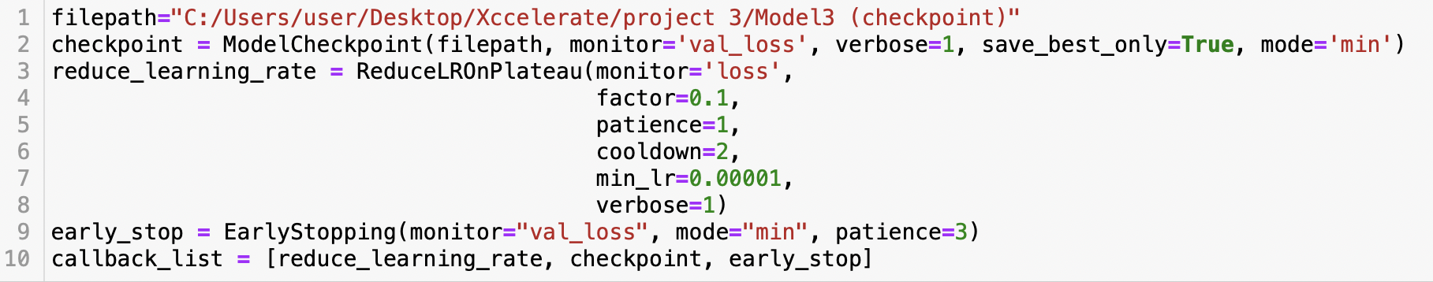
Callback List
ModelCheckpoint
ReduceLROnPlateau
EarlyStopping
Notes:
In order to make the model to be better, we put some callback function on the model
The first one is check point, ModelCheckpoint monitor the val loss, when the val loss is smaller than the previous one, it will save the epoch in the filepath, then we can use the best model to do the prediction
The second one is reduce the learning rate, it reduce the learning rate by factor 0.1
we also put early stopping in the callback list, which monitor the val loss, if the val loss does not improve for 3 epochs, it will stop the training. It can save the training time

Slide 11
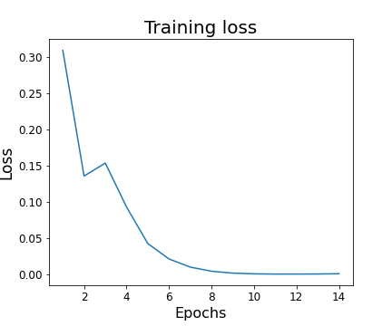
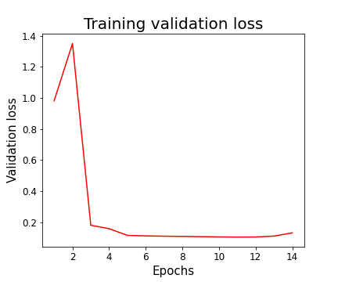
Training Loss and Validation Loss
loss: 3.6598e-04
val_loss: 0.1053
Notes:
These two graph show the loss and val loss of the training
Initially, the loss and val loss decrease significantly.
The training loss decrease slowly start from epoch 6, the lowest loss is in epoch 11, it is around 0.000367, which is close to 0.
The val loss decrease slowly start from epoch 3, the lowest val loss is 0.1053.
The val loss has no improvement in next 3 epochs, so early stopping function stop the training in the 14th epoch

Slide 12
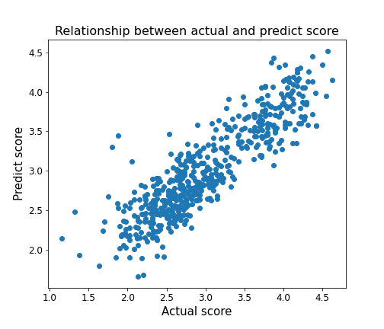
Evaluation
Evaluation score
0.106989
positive relationship between predict score and actual score
Notes:
the scatter plot shows the relationship between actual score and predicted score of test sets
we can see that there is a positive relationship between predict score and actual score
the evaluation score is around 0.1069, which is the loss between actual score and predicted score

Slide 13
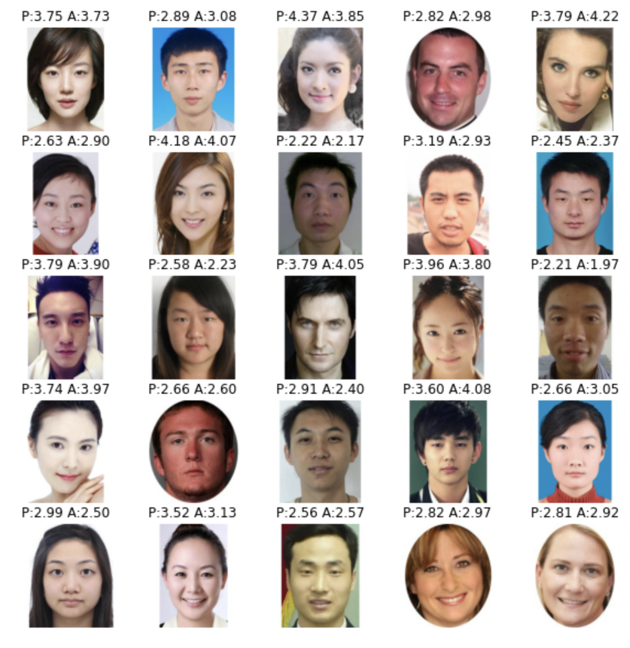
Prediction
Notes:
The graph random plot 25 people from test set
There is a predicted score and actual score above every photo
we can see that the score are close, most of difference not more than 0.5

Slide 14
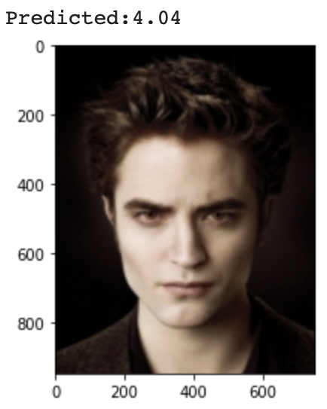
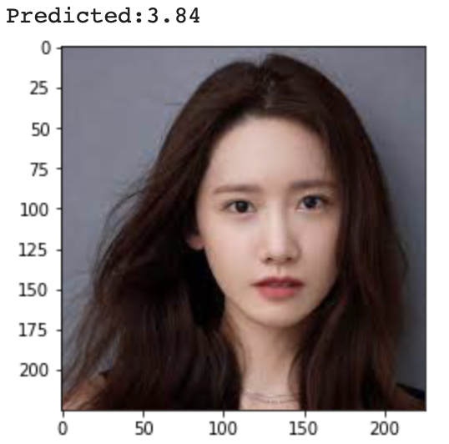
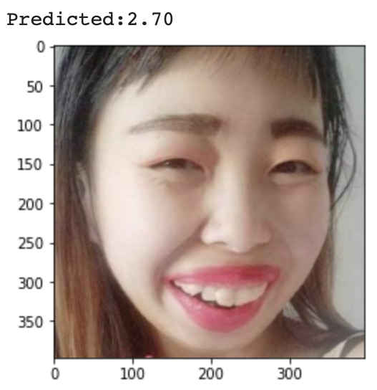
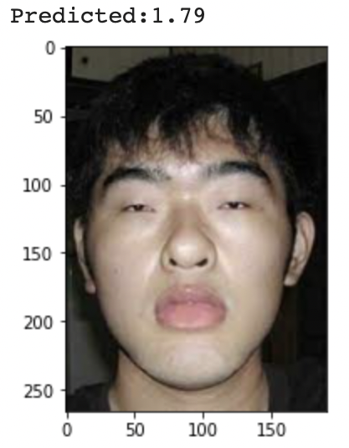
Prediction
Notes:
These are the photo we found in the internet, and the predicted score

Slide 15
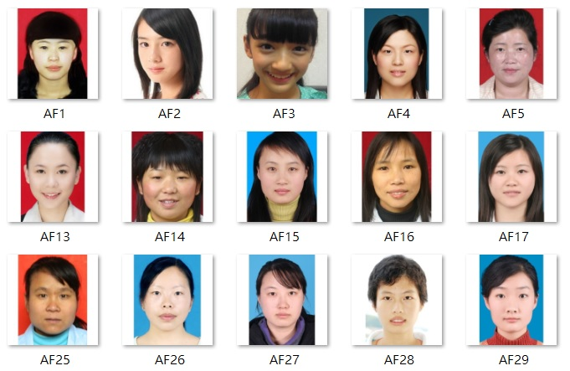

Face beauty Classification model
Initially we have 5500 pictures
60 people rated each photo
We divide them into 5 categories

Slide 16
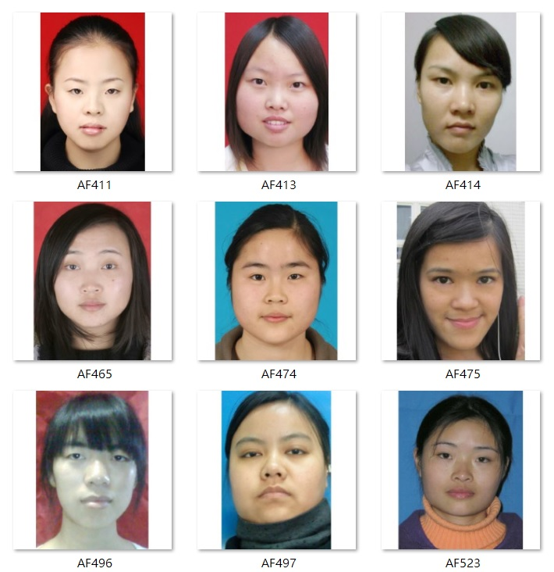
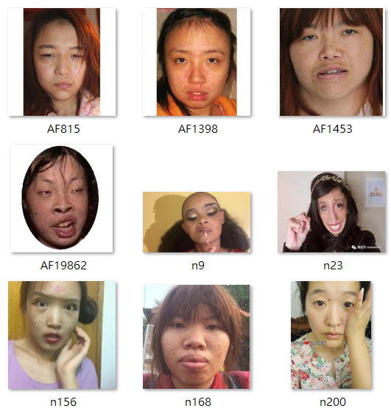
Score: 1
Score: 2
mean<1.5
mean>=1.5
mean<2.5

Slide 17
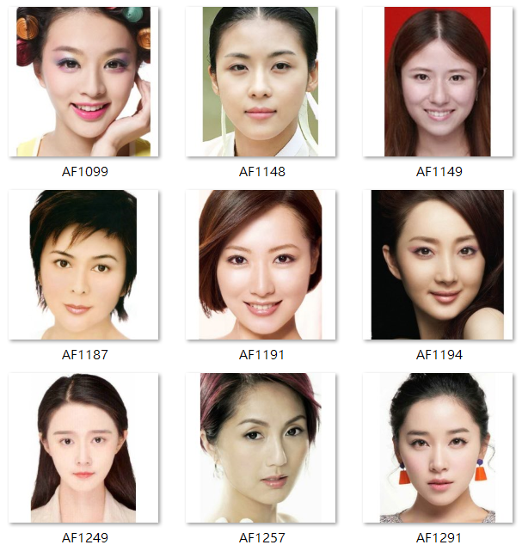
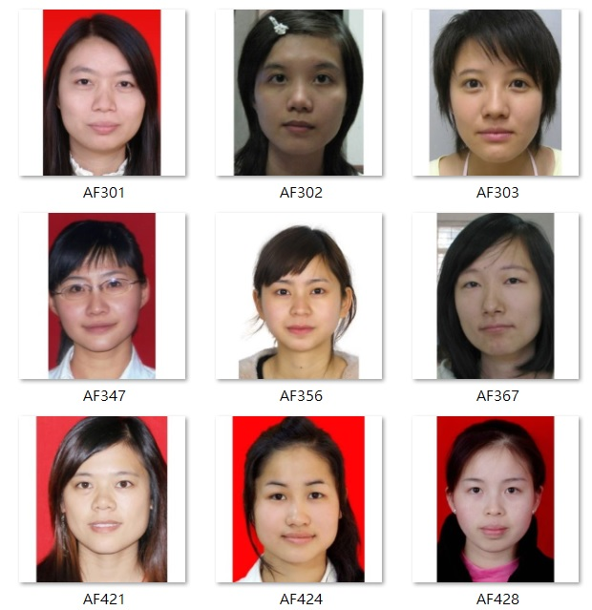
Score: 3
Score: 4
mean>=2.5
mean<3.5
mean>=3.5
mean<4.5

Slide 18
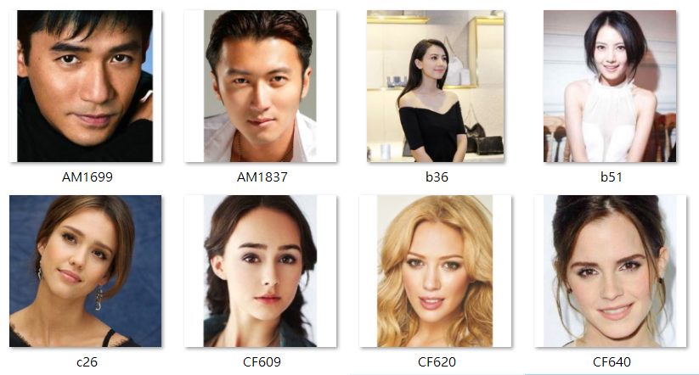
Score: 5
mean>=4.5

Slide 19
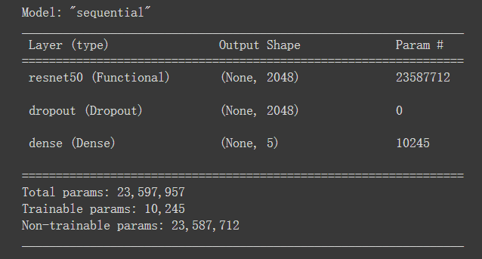
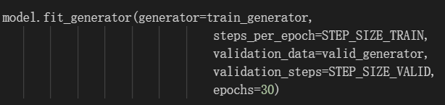
Transfer model: resnet50 structure

Slide 20
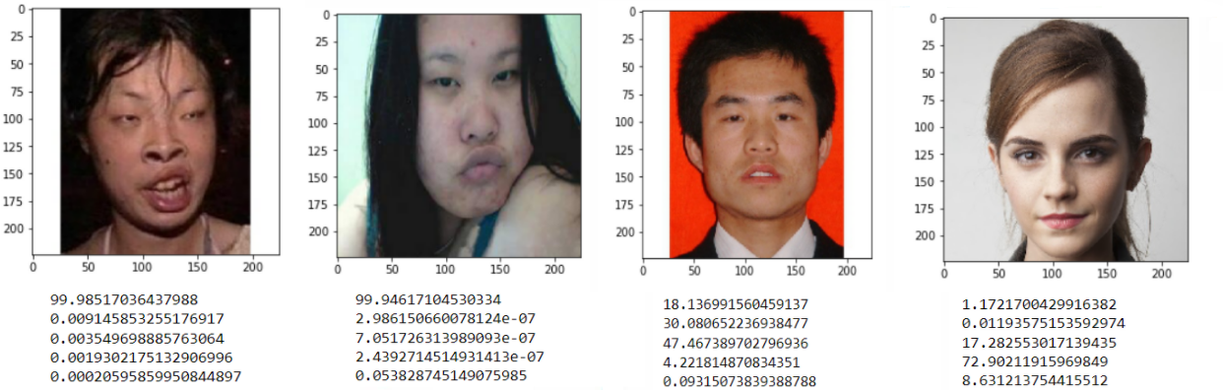
Result
few results are not make sense.
hair style ,pixel and background influence the assessment

Slide 21
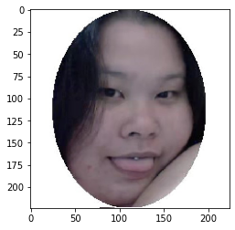
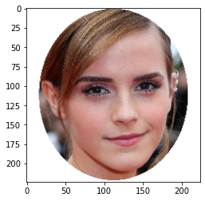
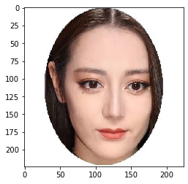
Improve Accuracy
Crop face

Slide 22
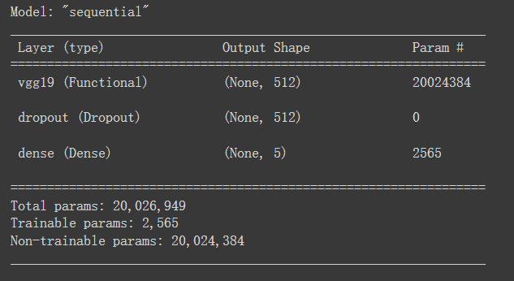
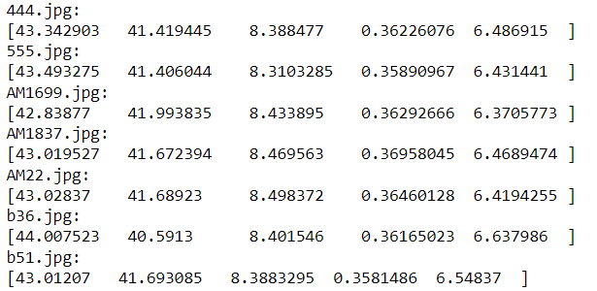
Other Transfer model (VGG19 )
for all class
Most pictures are evaluated as high probability score 1,2

Slide 23
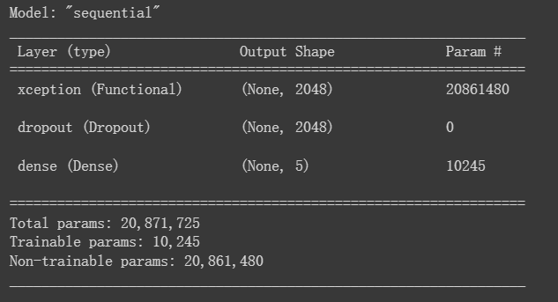
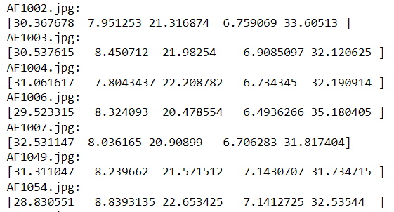
Other Transfer model (Xception)
for all class
Most pictures are evaluated as high probability score 1, 3, 5
VGG and Xception not suitable for this case

Slide 24

Conjecture of the project
Whole dataset
?
Male
Female

Slide 25
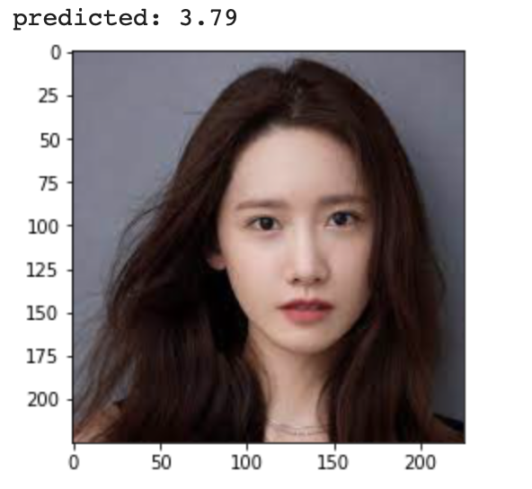
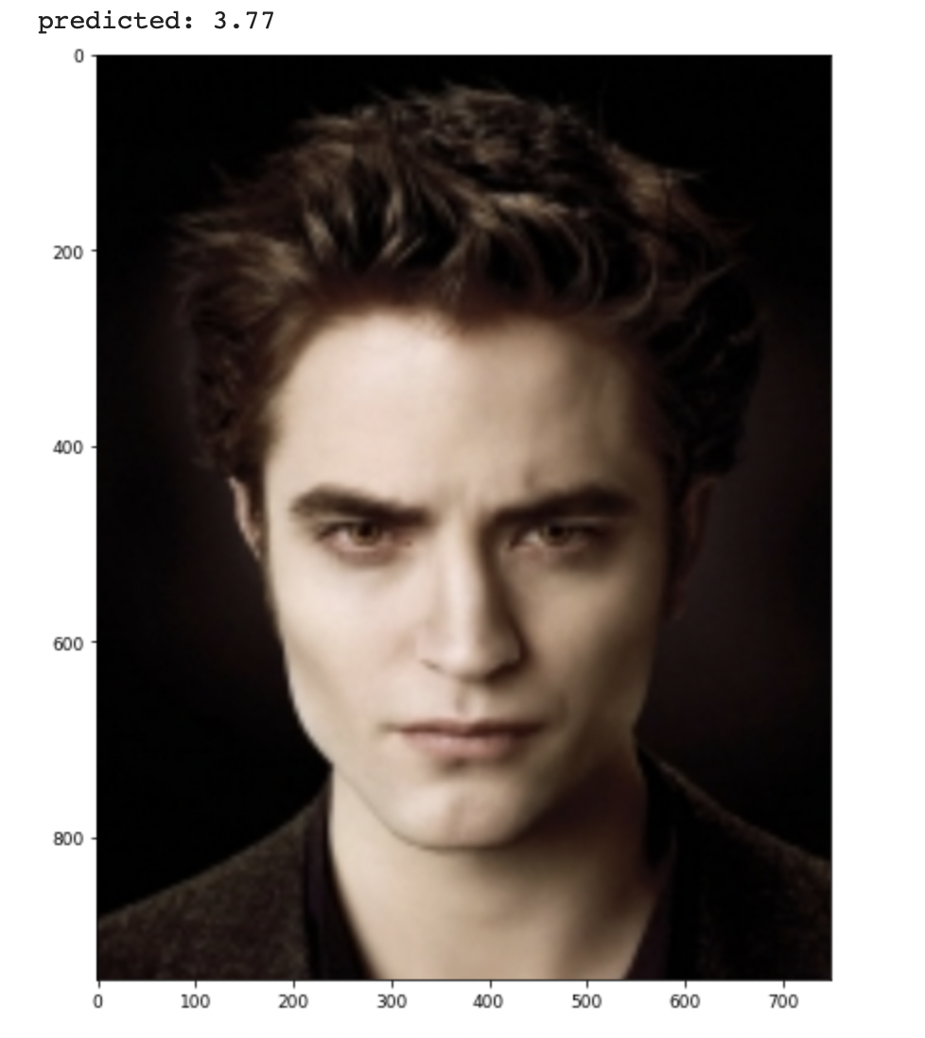
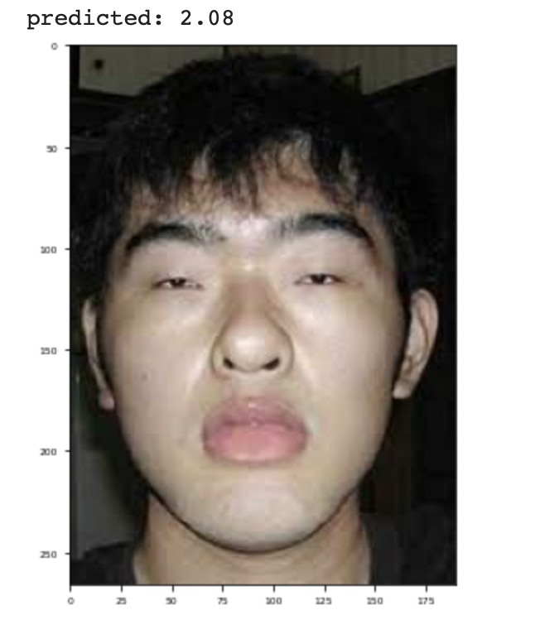
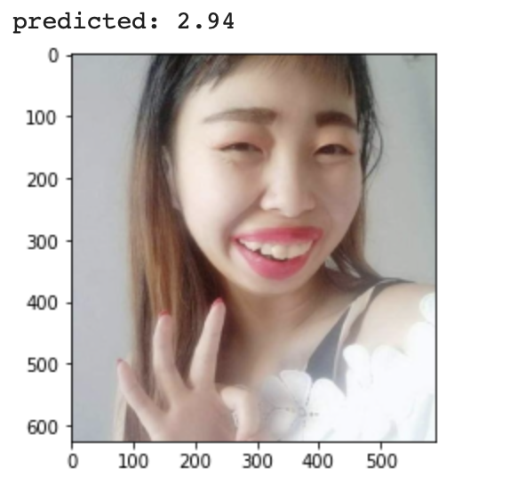

Slide 26
Conclusion

Slide 27
Q & A
Thank You~

